Slide 1
Navy Owned Unaccompanied Housing (UH) Inspection Guide
September 2022

Slide 2
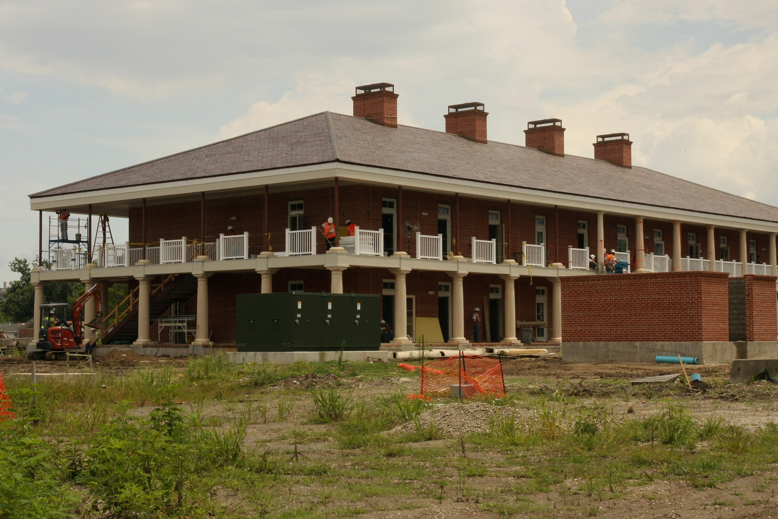
Objective
To provide guidance for conducting Unaccompanied Housing (UH) Inspections.

Slide 3
Reference/Responsibilities
NAVMED P-5010-2 (Rev. 2019)
PrevMed Responsibilities - PMA is responsible for conducting applicable sanitation inspections and preventive medicine related surveillance of all aspects of the operation and maintenance of housing and lodging facilities that are associated with health protection as required or at a minimum on an annual basis.

Slide 4
Responsibilities Cont.
It is also the PMAs responsibility to inform the CO via the chain of command concerning the sanitation status of all facilities.
The PMD is encouraged to work with the program managers to ensure SOP support an effective sanitary environment.

Slide 5

Responsibilities Cont.
Immediately following a complaint or regular inspection, the PMD should consult with appropriate personnel (e.g., safety personnel, industrial or OH personnel, emergency services, etc.) concerning any issues not related to sanitation or hygiene.

Slide 6
Responsibilities Cont.
Conduct sanitation and habitability inspections, to include reviewing weekly and monthly inspections performed by staff and safety personnel.
Inspections include:
  Barracks (Installation owned) student dormitories.
  Using the DOEHRS-IH EH module, Habitability Survey form.

Slide 7
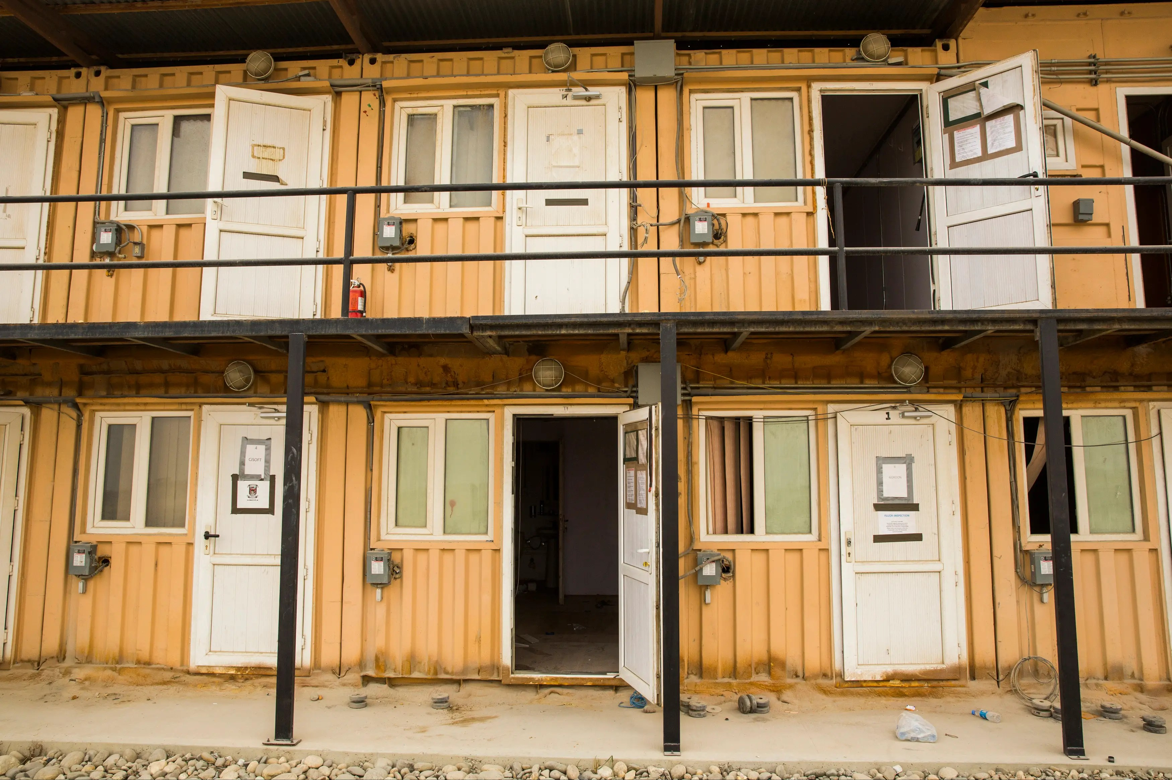
Definitions
Unaccompanied Housing. Military housing for unaccompanied personnel and is for enlisted, officers, and civilians at overseas locations. It includes permanent party, trainees, and students.

Slide 8
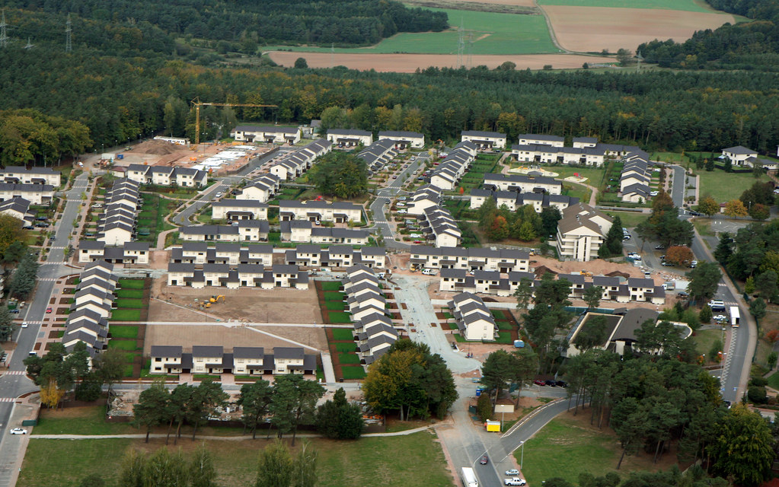
Definitions
DoD Housing. Family housing and unaccompanied housing that the DoD owns, leases, obtains by permit, or otherwise acquires. This is also referred to as “government-controlled housing.” It does not include privatized housing.

Slide 9
Definitions
Barracks. A building or group of buildings used to house unaccompanied permanent party military or civilian personnel.
Barracks. Unaccompanied housing consisting of a large open space with bunk beds and head facilities for a group of personnel. This type of living space can usually be found at training commands and in deployed environments.

Slide 10
Conducting the Inspection
Inspection
  Routine inspections must be conducted quarterly, but may be conducted more frequently , as needed.
  At least 5% of the total number of rooms must be inspected as part of a routine inspection.
  Conditions that necessitate more frequent inspections include, but not limited to, a high patron demand or turnover, a history of violations, or a failure to remedy violations.

Slide 11
Conducting the Inspection
Inspection
  Inspections must be performed during the normal operating hours of housing and without notice.
  The inspector will contact the Person-in-Charge (PIC) upon arrival and state the purpose of the inspection.
  The PIC will accompany the inspector during the inspection.

Slide 12
Conducting the Inspection
Inspection
  A representative from the PMD will document inspection findings using the DOEHRS-IH-EHM: Habitability Sanitation Report form and enter and attach to DOEHRS-IH, EH module.
  A copy of the completed inspection report must be provided to the PIC and results forwarded to the Installation CO (ICO) via the official Chain of Command.

Slide 13
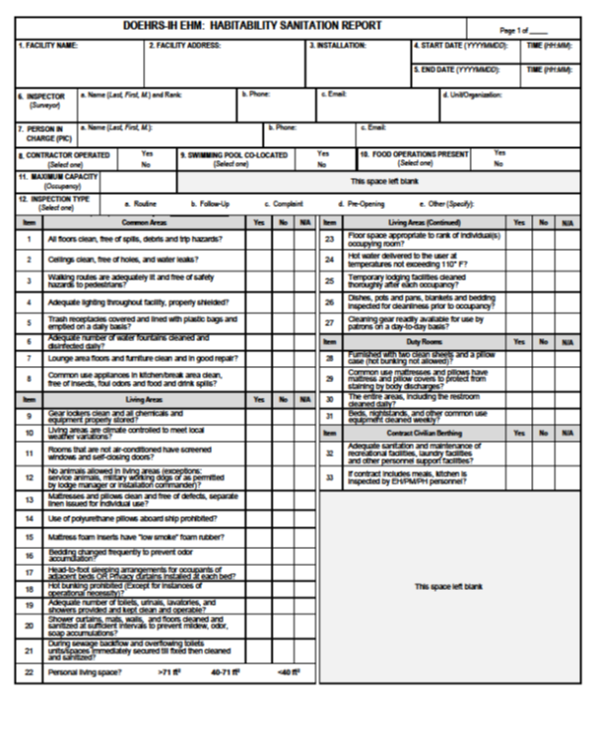
DOEHRS-IH-EHM: Habitability Sanitation Report form

Slide 14
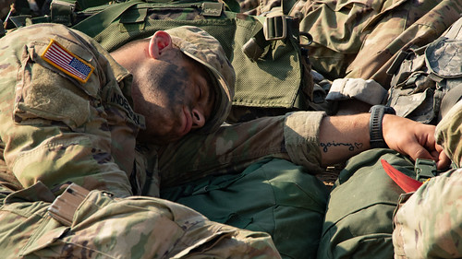
Unaccompanied Housing
Inspection
  Inspectors WILL NOT inspect those occupied quarters that are designated for “day sleepers” (quarters for individuals that work at night) during the day.

Slide 15
Unaccompanied Housing
Resident Responsibilities
  It is the responsibility of the assigned resident to maintain the living space in accordance with the standards established by the ICO.
  During occupancy, the resident must clean their assigned space on a regular basis.
  The housing office will inform residents to immediately report any maintenance or sanitation issues beyond the resident’s control.

Slide 16
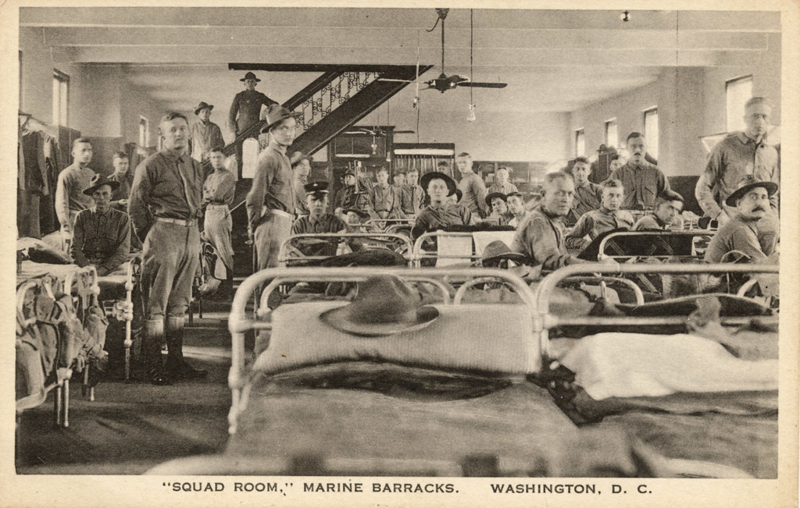
Unaccompanied Housing
UH Assignment Standards
  Residents must be provided space in UH per design standards unless a waiver is provided by the program manager.
  Requests for waivers to UH assignment criteria must be accompanied by a PMD review conducted within 1 month of the date of the request.

Slide 17
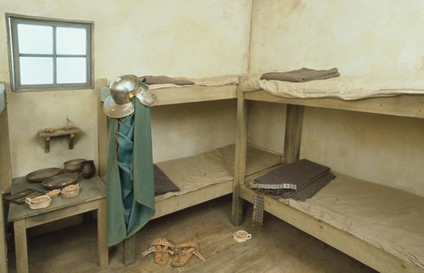
Unaccompanied Housing
UH Assignment Standards
  Consider a “head to toe” sleeping arrangement to minimize potential for transmission of respiratory diseases.

Slide 18
Unaccompanied Housing
Housing Office Minimum Sanitation Requirements
  Ensure cleaning and disinfection is completed using EPA approved product.
  Disinfect bathroom facilities to include floors, sinks, toilets, doorknobs, and other frequent human contact surfaces, DAILY.
  Launder linens and mattress covers at least WEEKLY.
  Change or launder blankets at least MONTHLY.
  When not in use, protect linens, mattress covers, and blankets from potential soiling or contamination.

Slide 19


Unaccompanied Housing
Housing Office Minimum Sanitation Requirements
  Sweep floors daily, mop floors weekly, and sweep and mop floors whenever visibly soiled.

Slide 20

Unaccompanied Housing
Pet Policy
  UH residents are not authorized to have any kind of live pet.

Slide 21
Unaccompanied Housing
Common Areas
  Cleaning must be conducted daily.
  Floors must be vacuumed or swept and mopped daily, if needed.
  Restrooms must have sufficient supply of hand soap, hand towels, toilet paper.
  Sinks, toilets, laundry, or other plumbing systems, functioning.
  Appliances must be in working order and free of debris and insects. Kitchen spaces cleaned daily.
  If gear lockers, they must be cleaned daily.

Slide 22

Unaccompanied Housing
Water
  Housing facilities must have an adequate water supply that meets the requirements of OPNAV M-5090.1, Environmental Readiness Program Manual, 25JUN2021 and NAVMED P-5010, Chapter 5, 01JUL2019.

Slide 23
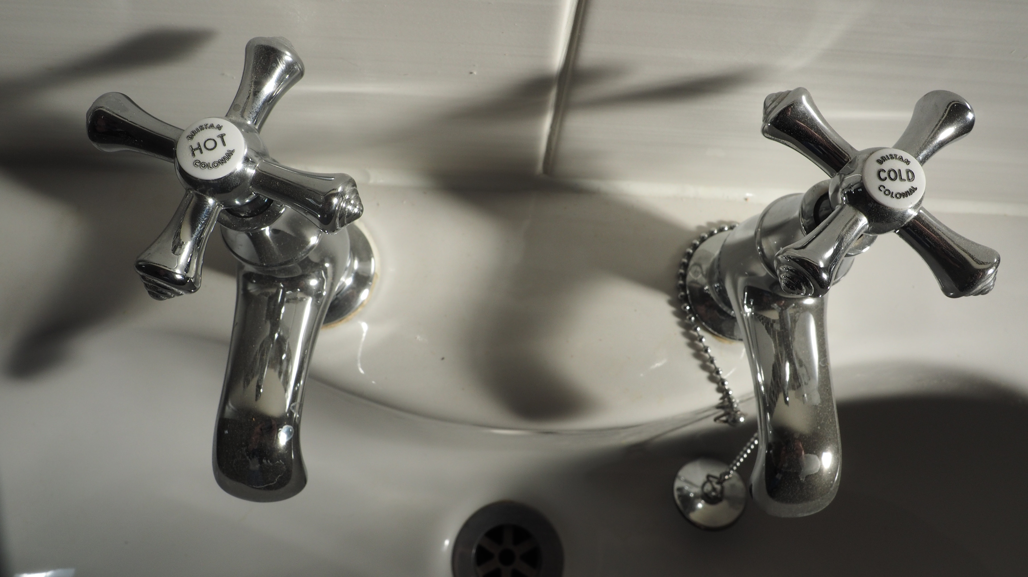
Unaccompanied Housing
Water Cont.
  There must be a supply of hot and cold water under pressure and discharged to an approved wastewater system.
  An available water supply must be sufficient to meet peak demands.
  Hot water delivered to the user at temperatures not exceeding 110F.

Slide 24



Unaccompanied Housing
Refuse
  The collection of refuse must occur with a frequency to inhibit the growth or attraction of disease vectors and pests.

Slide 25
Unaccompanied Housing
Refuse Cont.
  In accordance with 40 CFR 243, Solid Waste, Guidelines for the Storage and Collection of Solid Waste, which contains food wastes must be collected at a minimum of once weekly.
  Bulk wastes, every 3 month.
  All refuse must be stored in durable, fly-tight, and rodent-proof containers.
  Containers must be of sufficient capacity to prevent overflow.

Slide 26
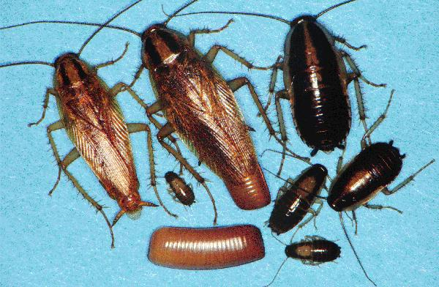
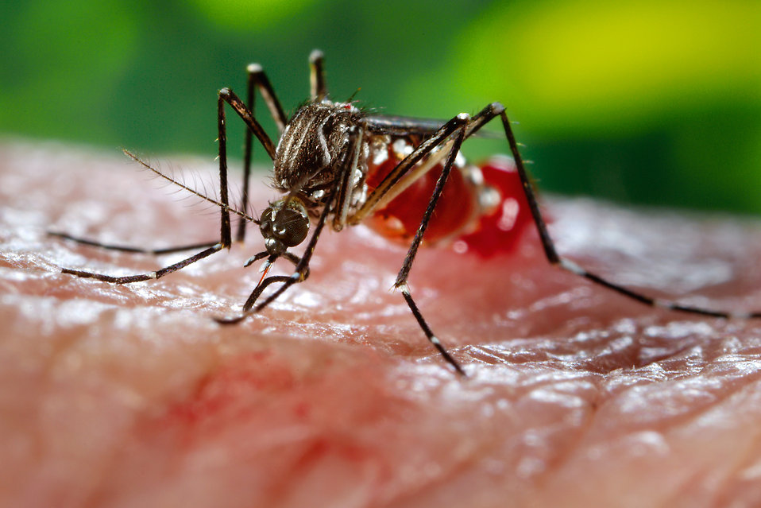
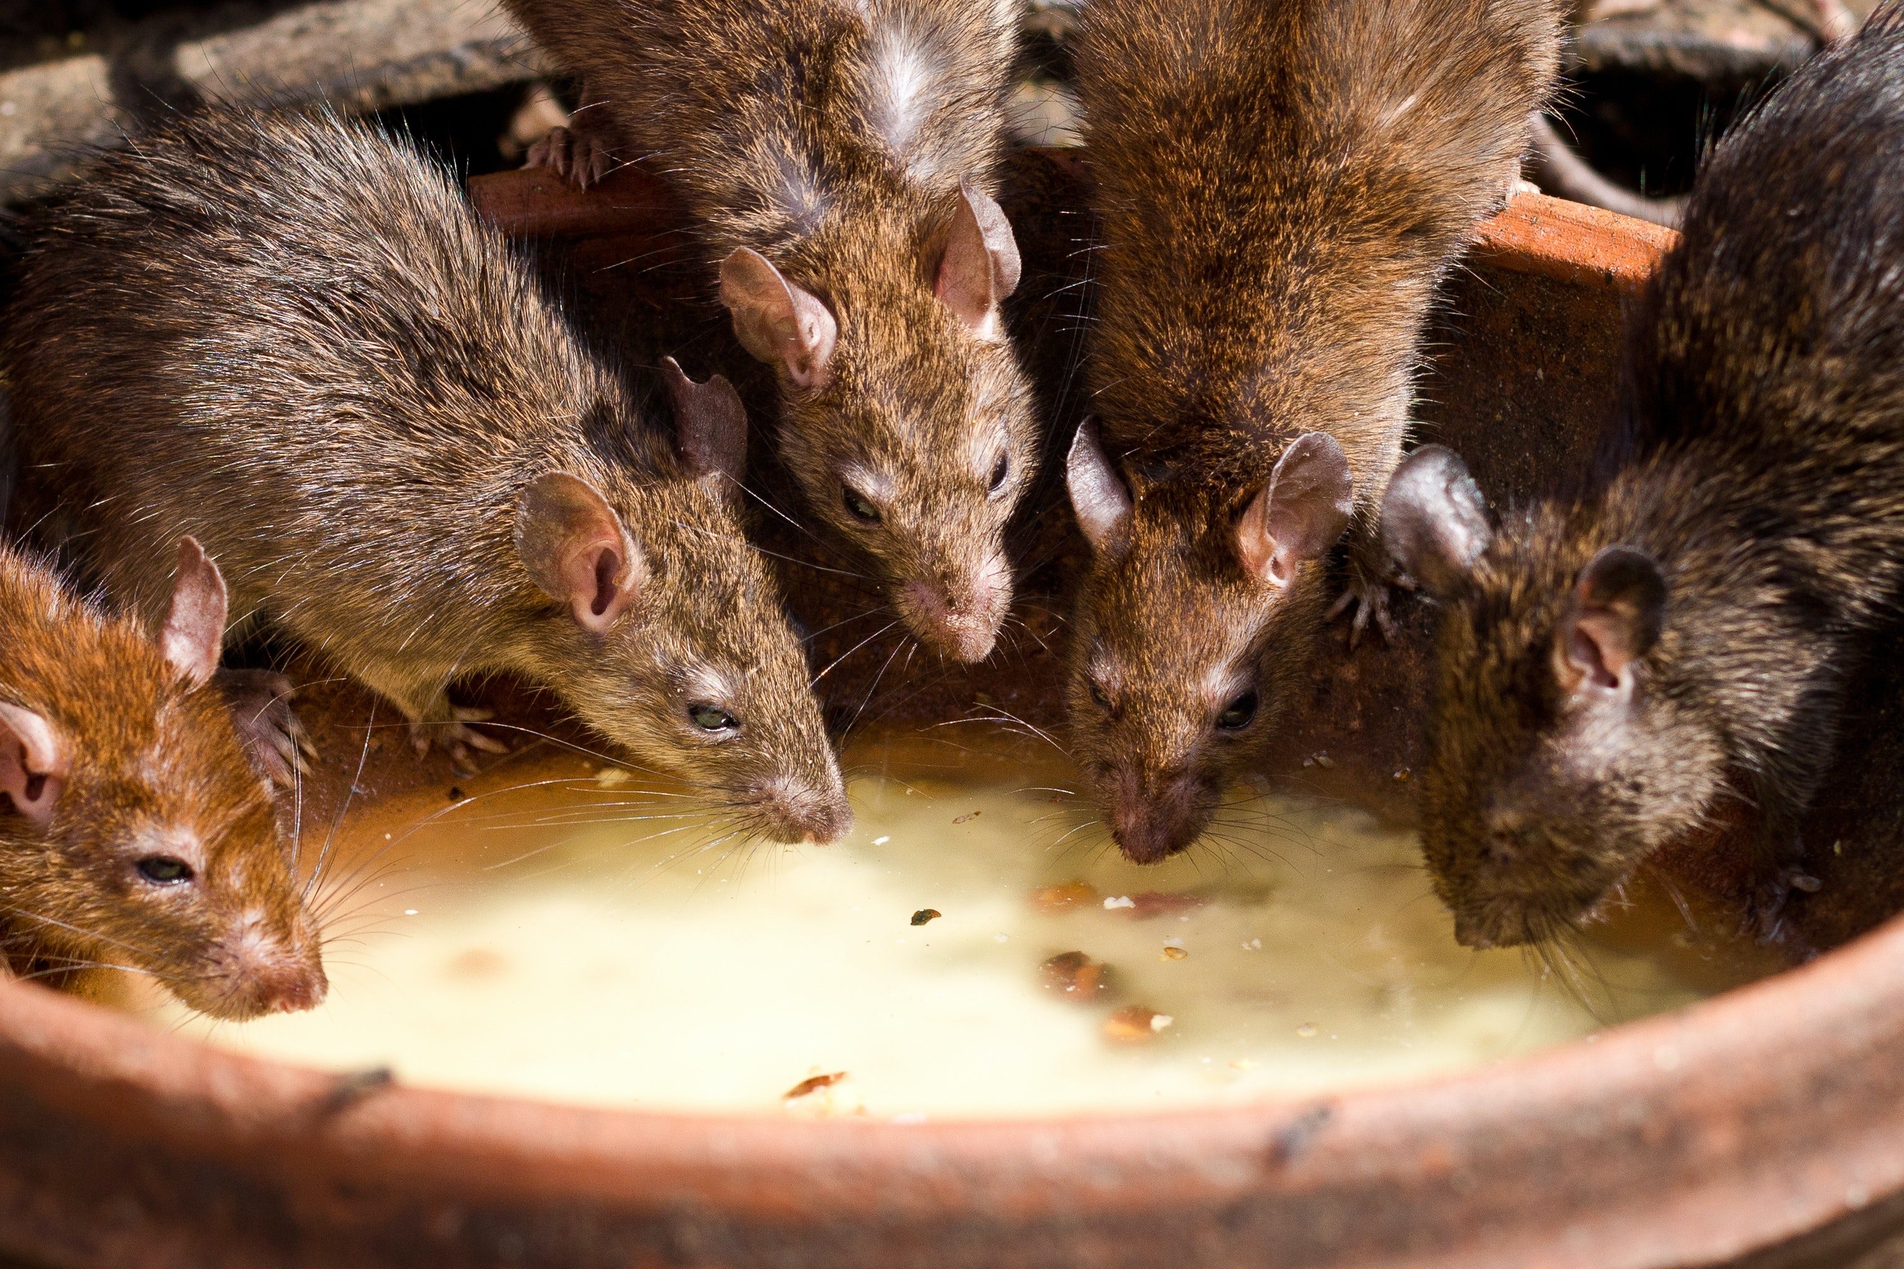
Unaccompanied Housing
Pest Control
  Per OPNAVINST 6250.4C, Navy Pest Management Program, pest control must be included as part of the installation’s Integrated Pest Management Plan (IPMP).

Slide 27
Unaccompanied Housing
Pest Control Cont.
  This plan may have pest management through NAVFAC or contractor.
  PMD will inspect for evidence of pest infestation and conditions that promote pest harborage or infestation.
  PMD will also verify NAVFAC or contactor is following their plan.
  PIC is adhering to all guidance by P-5010, Chapter 8.

Slide 28
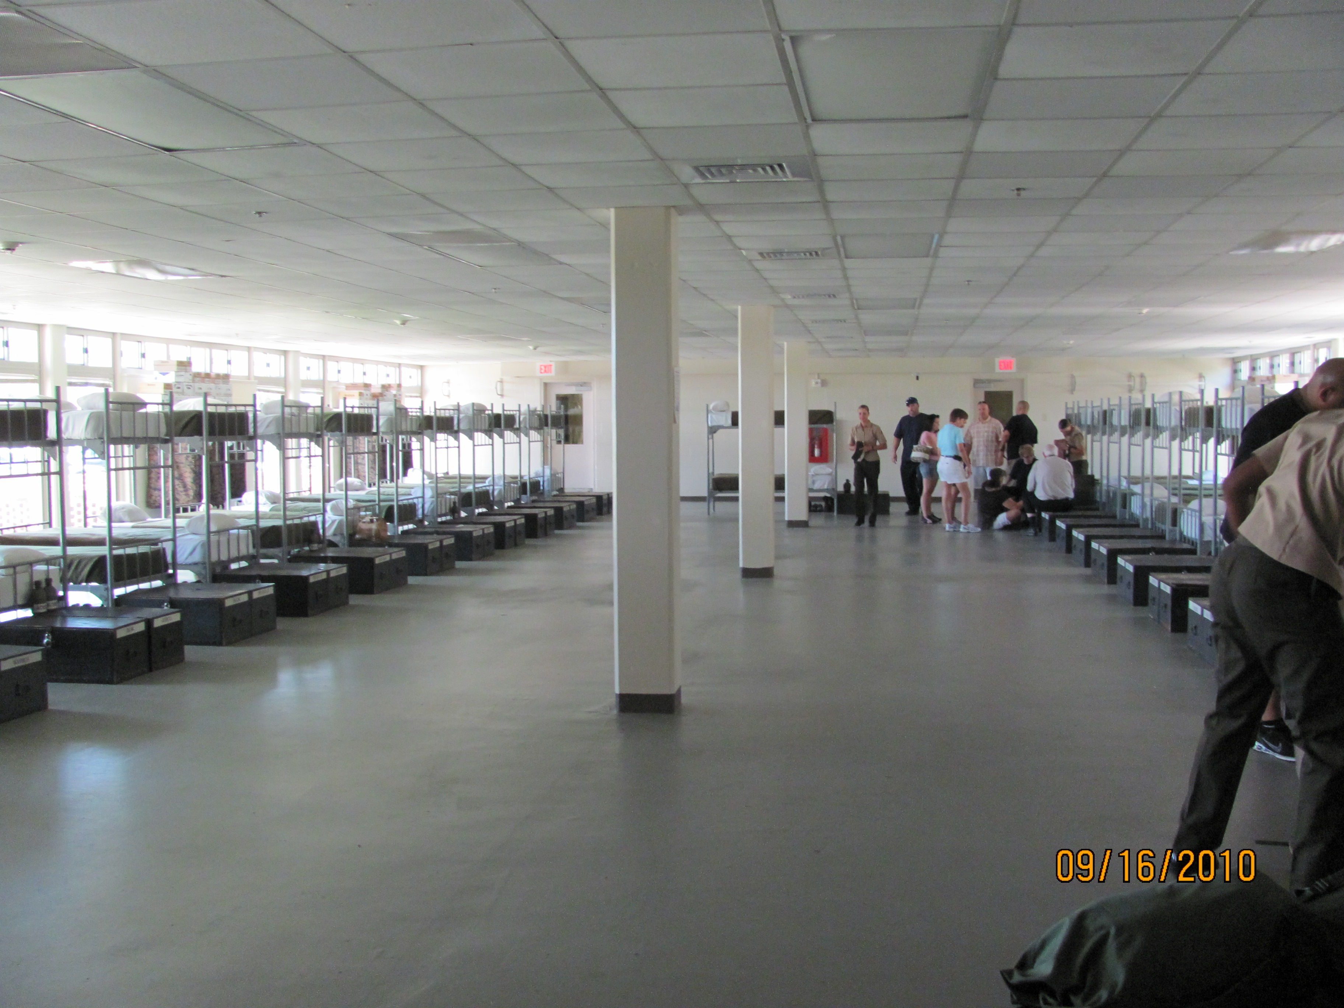
Unaccompanied Housing
Squad Bay locations (personnel in close proximity)
  Construction meets UFC requirements
  Disease control measures
    A minimum of 72 sf of floor space per person with 3 feet between sleeping arrangements.
    Consider “head to toe” sleeping reduce transmission of respiratory diseases.

Slide 29
Unaccompanied Housing
Squad Bay locations
  Cleaning and disinfection
    Daily for bathrooms includes floors, sinks, toilets, doorknobs etc…
    Linens and mattress covers laundered weekly.
    Blankets changed or laundered monthly.
    When not in use, linens, mattress covers, and blankets be protected from soiling or contamination.
    Sweeping and mopping must occur weekly unless visibly soiled.

Slide 30


